Slide 1
The learning picnic
Project Overview.

Slide 2

Supervised By
Joman Samir
The Learning Picnic
Majed Mamdouh
Asmaa Araby
Shihab Wael
Yara Mohamed
Omar Ahmed
Dr. Salwa Osama

Slide 3
Table of contents
01
Introduction .
02
Challenges .
03
Main goals .
04
System overview.
05
Transformers Based Models.
06
Summarization .
07
08
Reports .
Generating quiz.
09
Future works .
10
Reference .

Slide 4
Introduction
01

Slide 5
The learning picnic project .. why ?
The learning process was the focus of our attention, so we decided to design a project aimed at benefiting teachers and students, especially in the younger ages, to make them passionate about learning and knowing other things!
Therefore, we decided to make the name of our project “The Learning Picnic” so that it suits the young age group and also makes them feel that it is a real educational journey.
2

Slide 6
The learning picnic project .. why ?
Our motivation in this project is to make a website that make communication between the teacher and the student easier and to facilitate the teaching process for the teacher.
3

Slide 7

For whom ?
1
This system is designed for the subjects of the fourth stage of primary school and is intended only for subjects taught in the English language.
2
There are 4 main people who have a role in this system:
the teacher, the student, the parent and admin who is responsible for managing accounts.
4

Slide 8






Similar systems
 | Summarization | Quizzes | Reports
Brevity
Docsumo
ExamSoft
Quizlet
Selah El- Telmeez app
The learning picnic
5

Slide 9

Technologies
All models used in this project is written with python.
Backend is written with NodeJs using MVC pattern.
Using child process package in Nodejs we connect between the backend and models.
Database is MongoDB.
Frontend is written with ReactJs and Tailwind framework.
Frontend is responsive.
6

Slide 10
Challenges
02

Slide 11
Challenges
The challenge we encountered was related to the single-threaded nature of Node.js, which limits our ability to handle multiple processes simultaneously.
After researching, we decided to implement the concept of child processes using the spawn function from the child_process library.
This approach allows us to harness the full power of our processor.
8

Slide 12
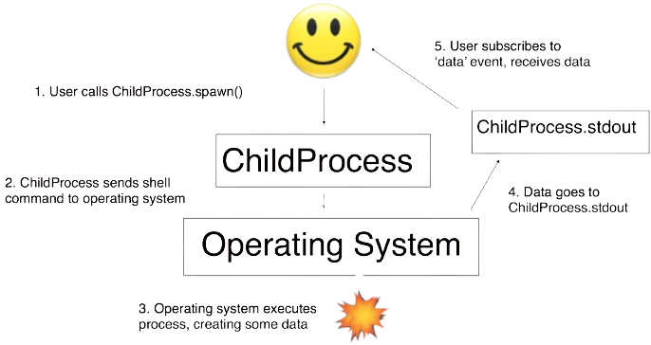
Challenges
We chose spawn over exec because exec would interrupt the first process to start the second one, whereas spawn can handle multiple processes in parallel.
Additionally, spawn is capable of handling larger files and data more efficiently.
We use the spawn function to ensure that everything on the website operates asynchronously.
9

Slide 13
Main goals
03

Slide 14



Main goals
Summarization
Generatinng quizzes
Reports
11

Slide 15
System overview
04

Slide 16
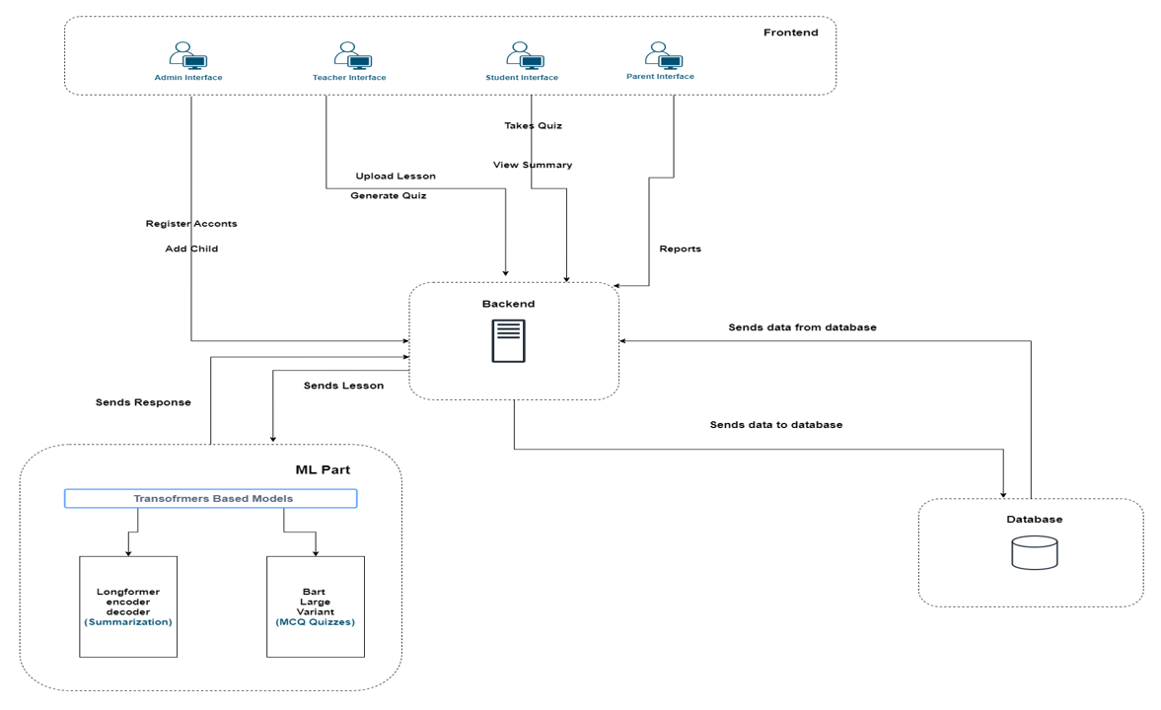
T5
Large
Variant
13

Slide 17
Transformers Based Models
05

Slide 18
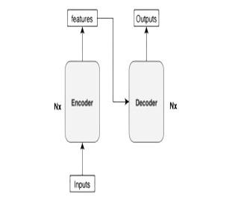

History of transformers model
The evolution of sequence models in natural language processing, specifically machine translation and sequence generation, began with the adoption of the seq2seq model, Initially implemented using RNNs or CNNs.
15

Slide 19
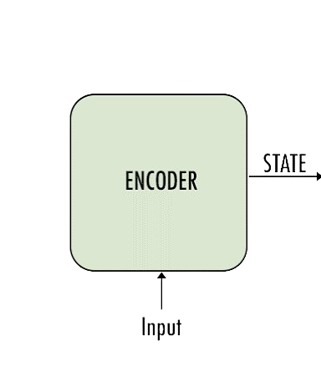
History of transformers model
this model consisted of two fundamental components:
Encoder>> Responsible for processing input sequences to derive a fixed context representation
16

Slide 20
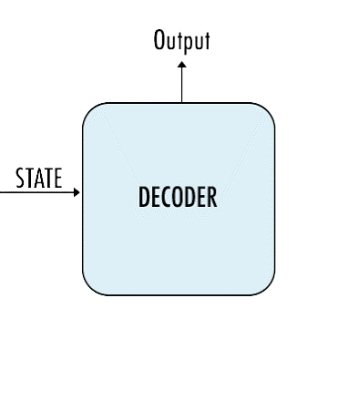
History of transformers model
Decoder >> Utilized the encoded context to generate output sequences.
Despite its initial use, the seq2seq model encountered inefficiencies and limitations across various tasks. Consequently, the concept of the transformers model emerged to address these challenges more effectively.
17

Slide 21
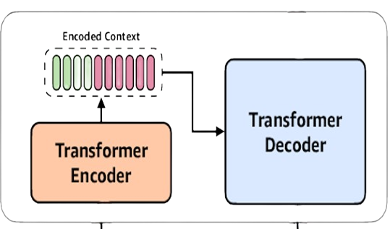
transformers
Transformers >> are effective at managing overfitting and can handle large input lengths. They consist of multiple encoders and decoders that are interconnected, often having up to six encoders and six decoders.
However, transformers also have limitations, such as being able to process tokens up to a maximum length of 1024 only.
18

Slide 22
Summarization
06

Slide 23
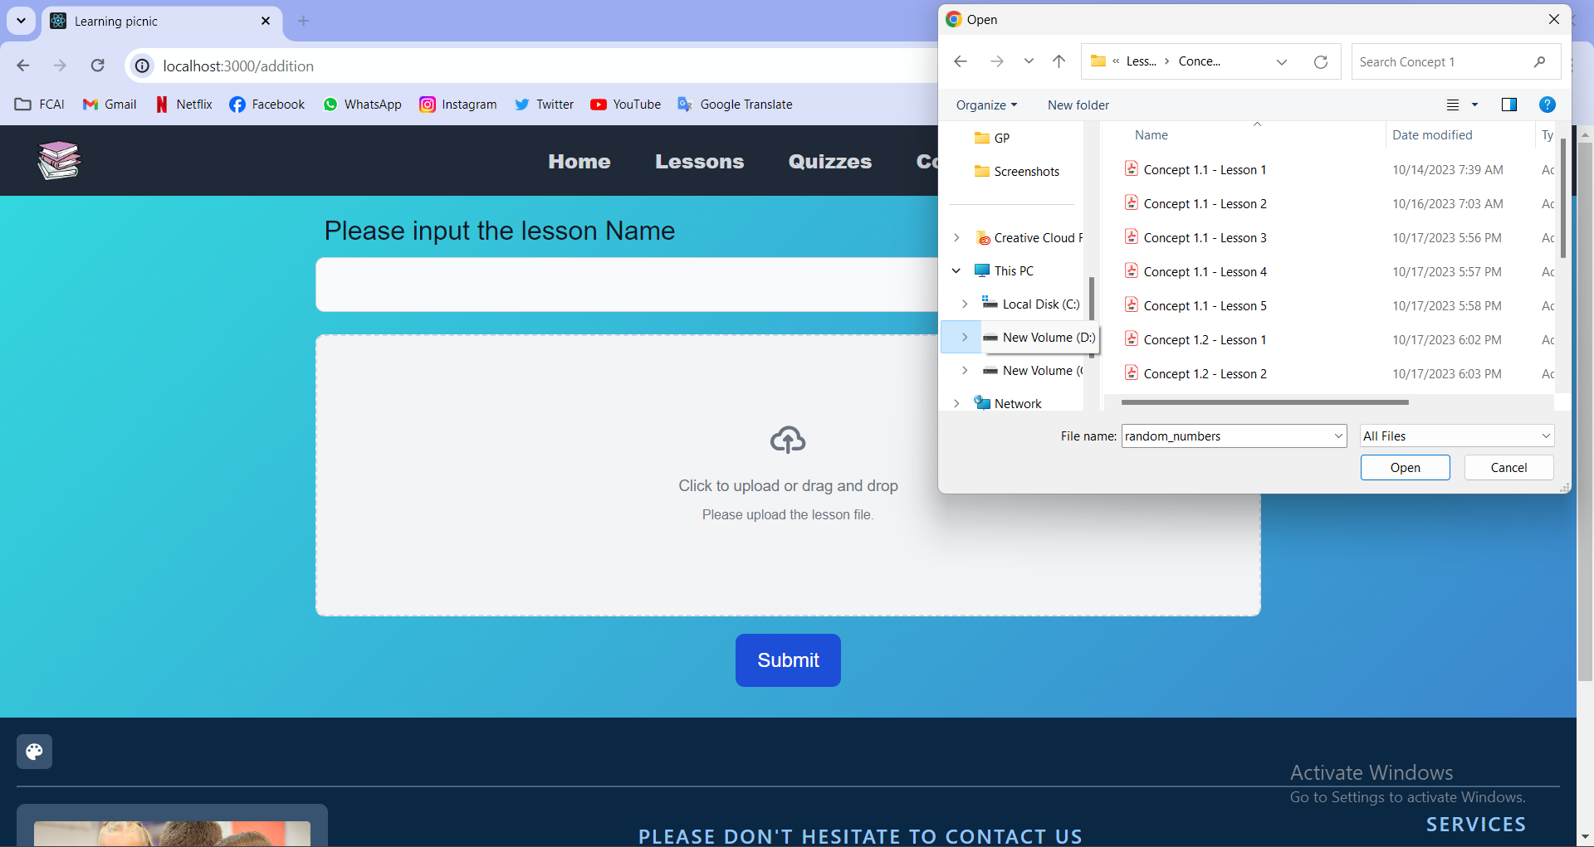
20

Slide 24
Backend Integration with Summarization Model
When the teacher chooses to upload a lesson, the lesson controller will save the lesson information to the database and pass the PDF file to the summarization model using the spawn function from the child process library. Once the model completes its task, it stores the summary of the lesson in the database.
After this process, the student can easily access the lesson and its summary.
21

Slide 25
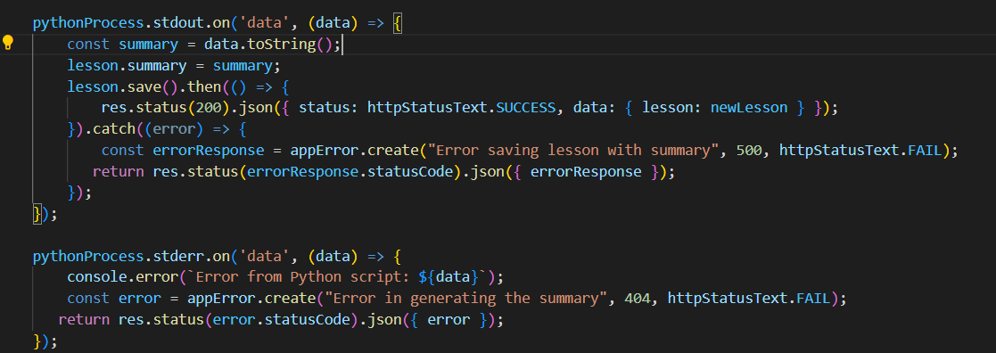
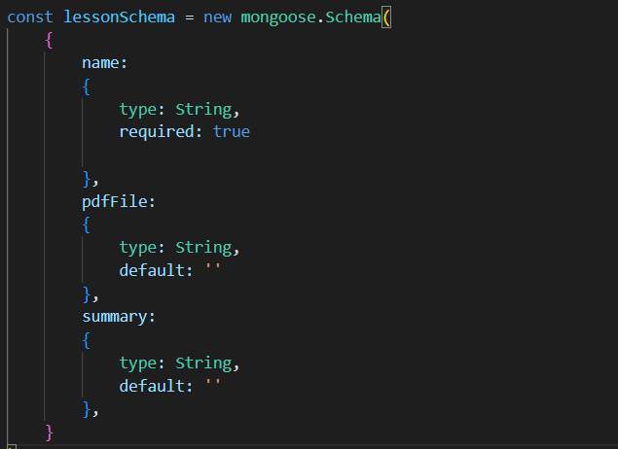
let’see
22

Slide 26
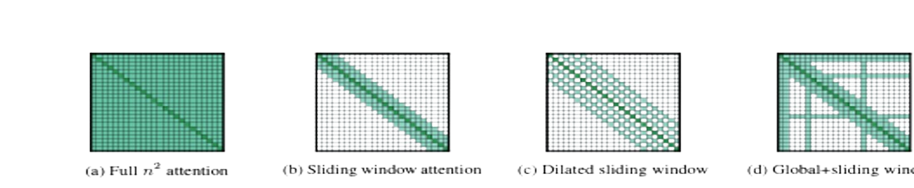
Longformer
Longformer is a modified Transformer architecture that uses an attention pattern that scales linearly with sequence length. This design allows it to efficiently process documents with thousands of tokens or more.
23

Slide 27
Longfromer Encoder-Decoder (LED)
Longformer-Encoder-Decoder (LED) is a variant of Longformer designed for generative sequence-to-sequence tasks. The encoder leverages the efficient local and global attention pattern of Longformer, while the decoder employs full self-attention to the entire encoded tokens and previously decoded locations.
This model is suitable for tasks such as summarization and can handle inputs of up to 16,384 tokens in length.
24

Slide 28
BART vs. LED in Document Processing Efficiency
In a comparison between BART and LED, their performance may be similar on small text samples. However, the difference becomes evident when testing on large-scale documents. LED's architecture is optimized for handling longer sequences, which allows it to maintain performance and efficiency when processing large documents, whereas BART may struggle with long input lengths.
25

Slide 29
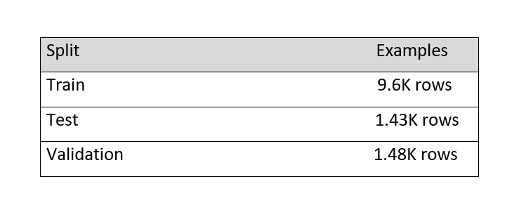
Summarization dataset
BookSum is a dataset for long-form narrative summarization, containing source documents from literature with paragraph-, chapter-, and book-level human-written summaries, posing challenges like processing long documents and rich discourse structures.
26

Slide 30
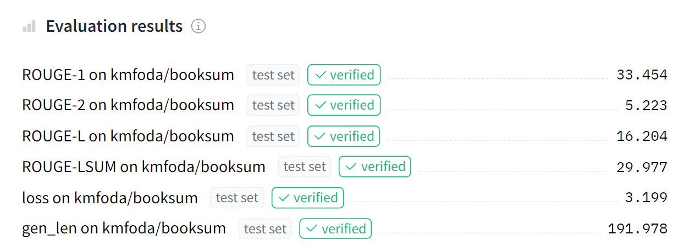
Model Accuracy
We used a pretrained Longformer-Encoder-Decoder (LED) model and fine-tuned it on the BookSum dataset, achieving the following level of accuracy .
27

Slide 31
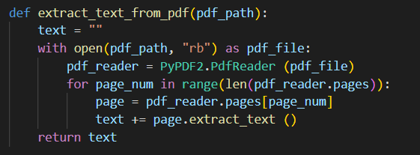
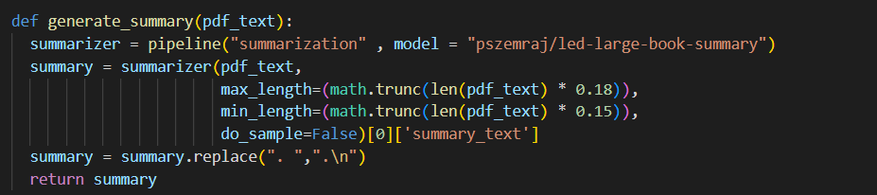
Text Extraction and Model Integration
Firstly, we take the PDF as a document and pass it to a function to extract the text from it.
Secondly, the extracted text is passed to the model. We use the Transformers library in Python, which provides an API called pipeline that handles the necessary task and model.
28

Slide 32

Generating Quizzes
07

Slide 33
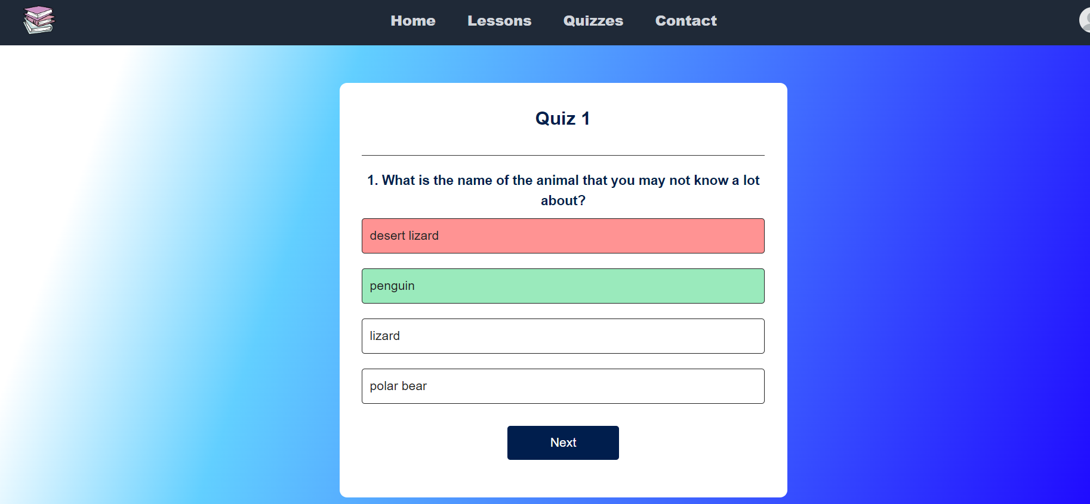
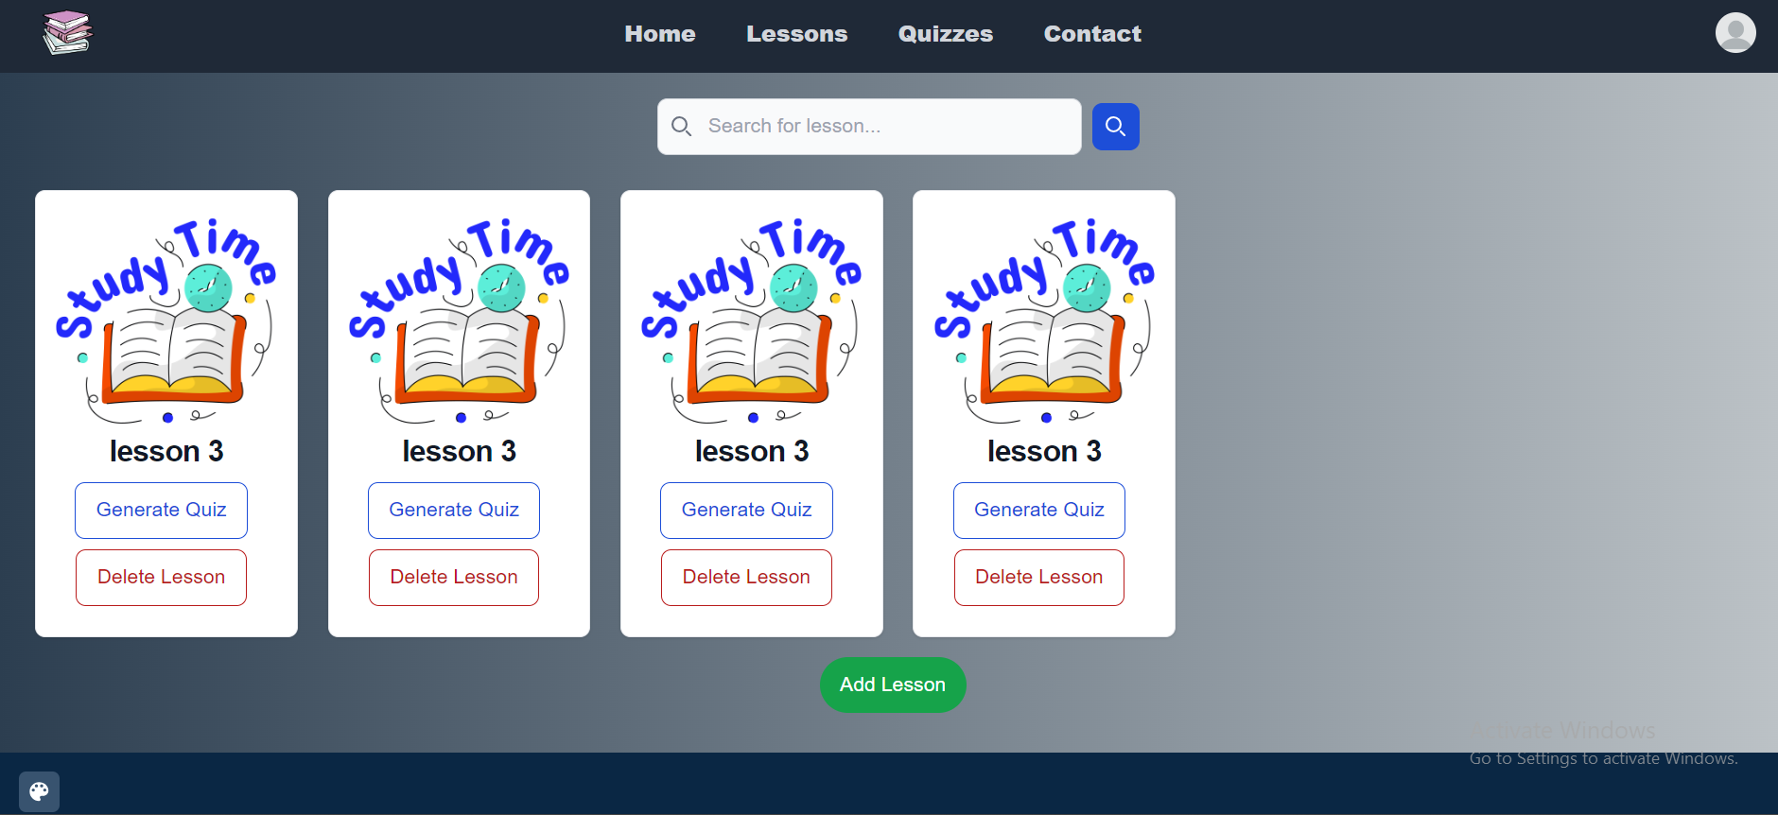
,
30

Slide 34
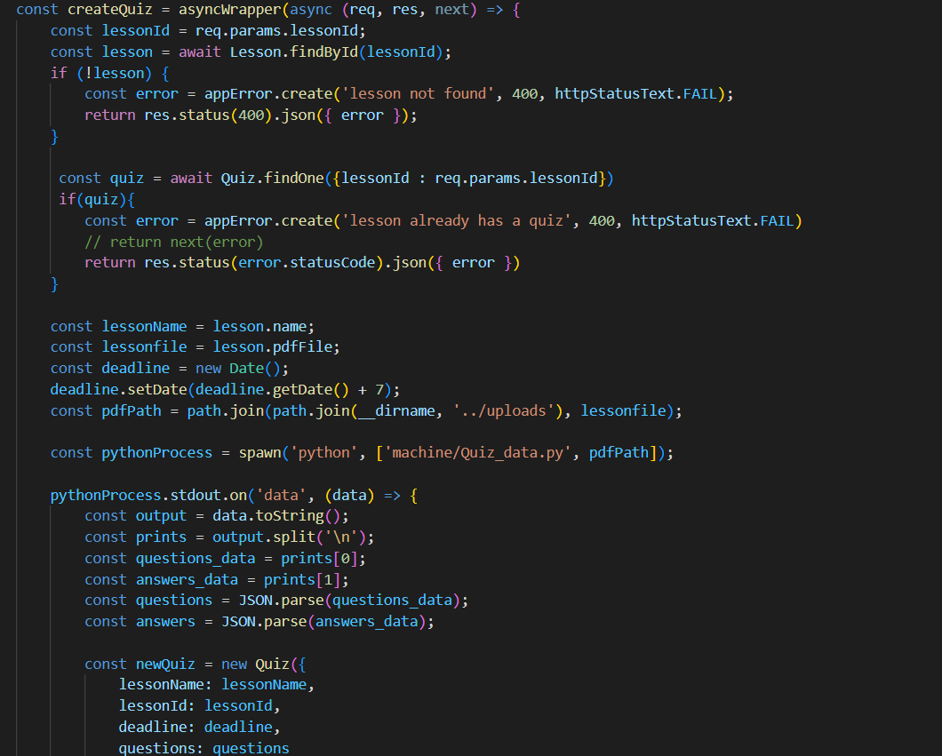
Backend Integration with MCQ Quiz Model
Now, the teacher can easily choose any uploaded lesson to generate a quiz from it.
31

Slide 35
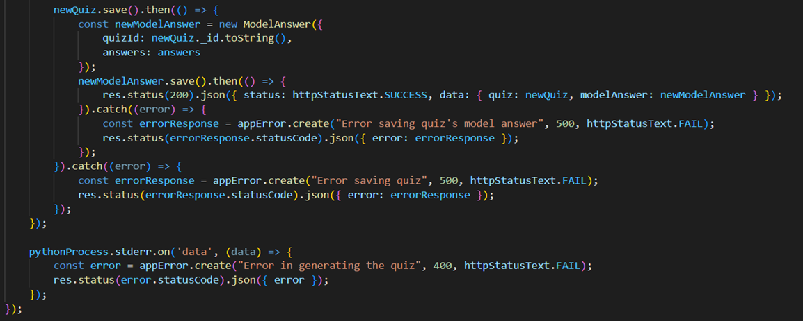
Backend Integration with MCQ Quiz Model:-
The quiz controller connects to the model through the spawn method, which takes the generated questions as an array of JSON objects and stores them in the database Additionally, it stores the correct answers.
After this process, students can easily view and take the quizzes.
32

Slide 36
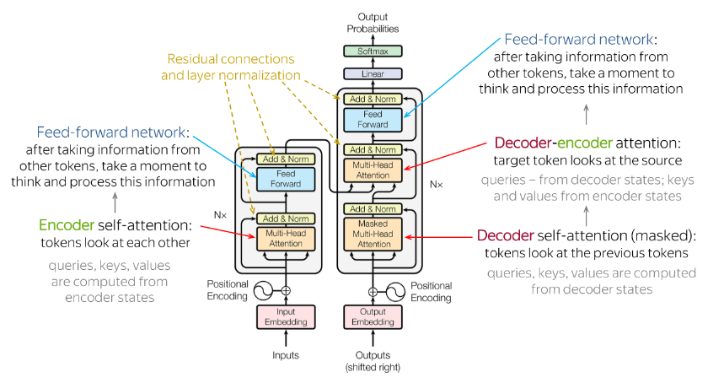
T5 Model
In achieving this goal, we use the T5 model, a transformer-based model that utilizes 12 encoders and decoders, following the default structure of transformer architecture.
33

Slide 37
T5 Model
T5 introduces a unified framework where all NLP tasks are formulated as text-to-text tasks, meaning that both the input and output are treated as text.
34

Slide 38
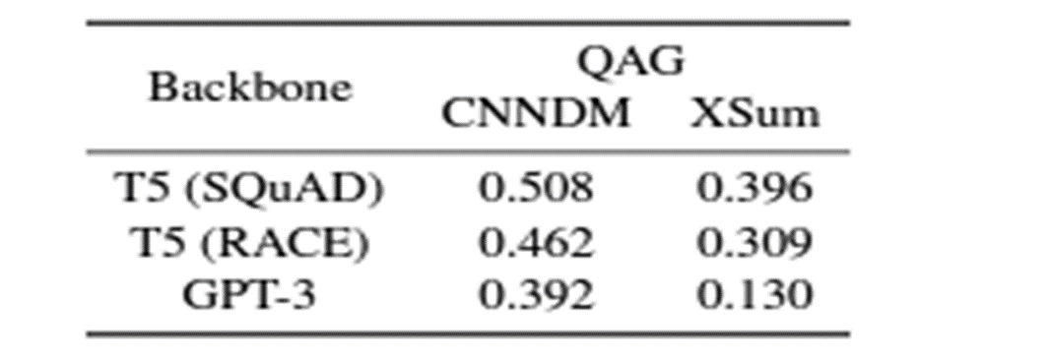
T5 vs. GPT: MCQ Quiz - Balancing Text Consistency and Complexity
In this field, GPT models present a promising alternative. However, as GPT models generate text sequentially, they may not always guarantee perfect consistency across long passages.
To address this, we used the large variant of T5, which has more parameters and can capture more complex patterns in the data. This potentially leads to improved performance in our tasks.
35

Slide 39
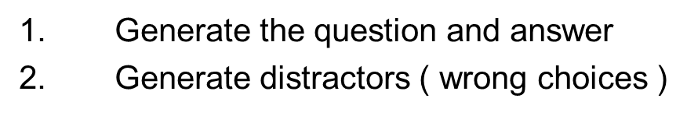
Generating Quizzes Datasets
This task is divided to 2 parts:
36

Slide 40
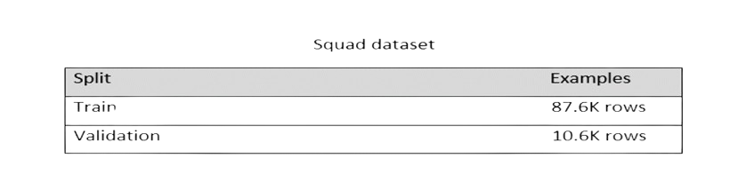
Generating Quizzes Datasets
For the first part we used fine-tuned t5 on Squad dataset .
SQuAD is a question-answering dataset with diverse, human-produced question-answer pairs from Wikipedia articles.
37

Slide 41
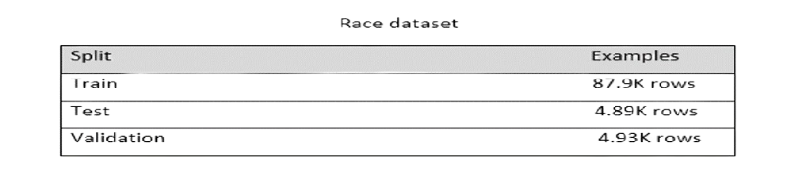
Generating Quizzes Datasets
For the second part we used fine-tuned t5 on Race dataset (for distractors) .
The RACE dataset is a machine reading comprehension dataset consisting of 27,933 passages and 97,867 questions from English exams, Each question is associated with 4 candidate answers, one of which is correct.
38

Slide 42
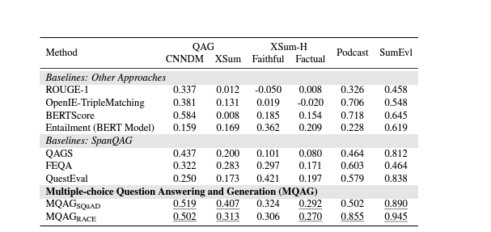
Model accuracy
According to the paper, this model achieves the following accuracy :
39

Slide 43
Text Extraction and Model Integration
First, we extract the text from the PDF file and split the extracted text into paragraphs, each ranging from 3 to 7 sentences.
Each paragraph is then passed to the first model, which generates a question and answer.
The generated question, answer, and paragraph are subsequently passed to the second model to generate distractors (wrong choices).
40

Slide 44
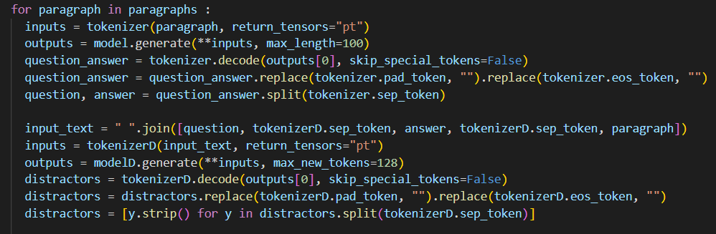
Text Extraction and Model Integration
We create a list of wrong choices and append the actual answer in a different index for each paragraph. If there are any duplicates in the list, we remove them .
41

Slide 45
MCQ Quiz Output Sample:
1
What does the starred agama do to keep cool?
a. Find shade.
b. Find water.
c. Find food
3
What do pinguins feet help them to survive in?
a. Hot climate .
b. Cold climate.
c. Warm climate.
2
What is the name of the animal that you may not know a lot about ?
a. Polar bear.
b. pinguin.
42

Slide 46
MCQ Quiz Output Sample:
What is the camouflage ?
4
What do polar bear blend in with when sneaking up on prey?
5
a. It is the adaption that hide the animals from a predator or their prey.
b. It is the adaption that hide animals from their predator ..
c. It is the adaption that hide animals from their prey .
a. Tree .
b. Snow .
c. Forest .
d. Thick, white fur.
43

Slide 47
Reports
08

Slide 48
Reports:
Following the generation of quizzes, students may elect to undertake any designated quiz at its allocated time.
Upon completion of a quiz, the student's grade is archived in a database, Additionally, each answered question is accompanied by a percentage indicating the frequency of correct responses for that question, This mechanism aids in the analysis of each quiz by the teacher, facilitating the identification of challenging or erroneous questions. All pertinent data is stored in the database and subsequently retrieved for reporting purposes.
45

Slide 49
The types of reports available to each role are as follows:
Student's Grades Report: This report is accessible to the student and their parent, offering an overview of the student's grades.
Students' Grades Report: This report is accessible to the teacher, providing an overview of grades for all students.
Question Analysis Report: This report scrutinizes the correctness rates of individual questions based on the number of times they were answered correctly.
46

Slide 50
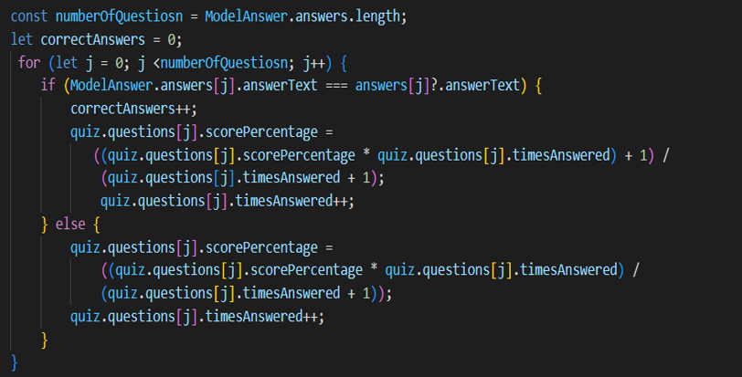
Report Generation Steps
When a student takes a quiz, their answers are graded based on the model answer (which was generated with the quiz). Each time a question is answered, the times Answered value is incremented to calculate the percentage of correct answers. These values are then stored in the quiz schema in the database for future reference.
.
47

Slide 51
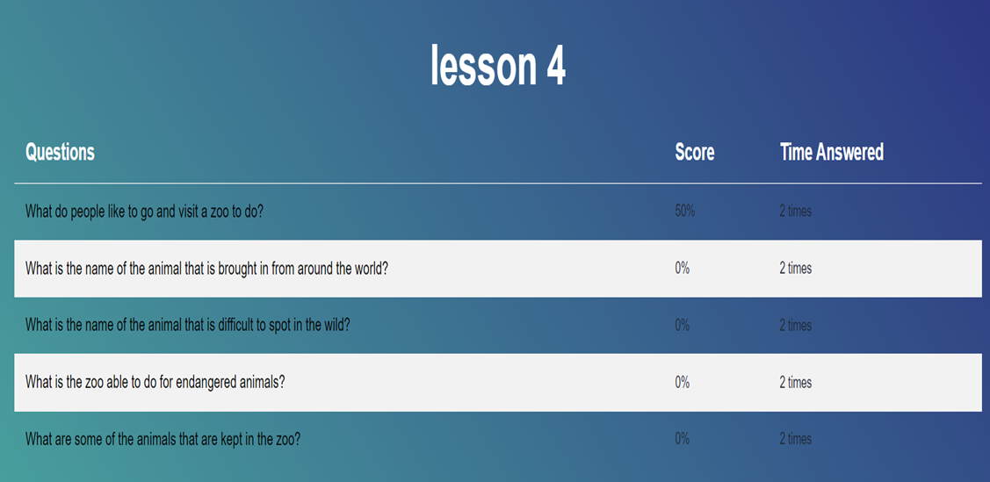
48

Slide 52
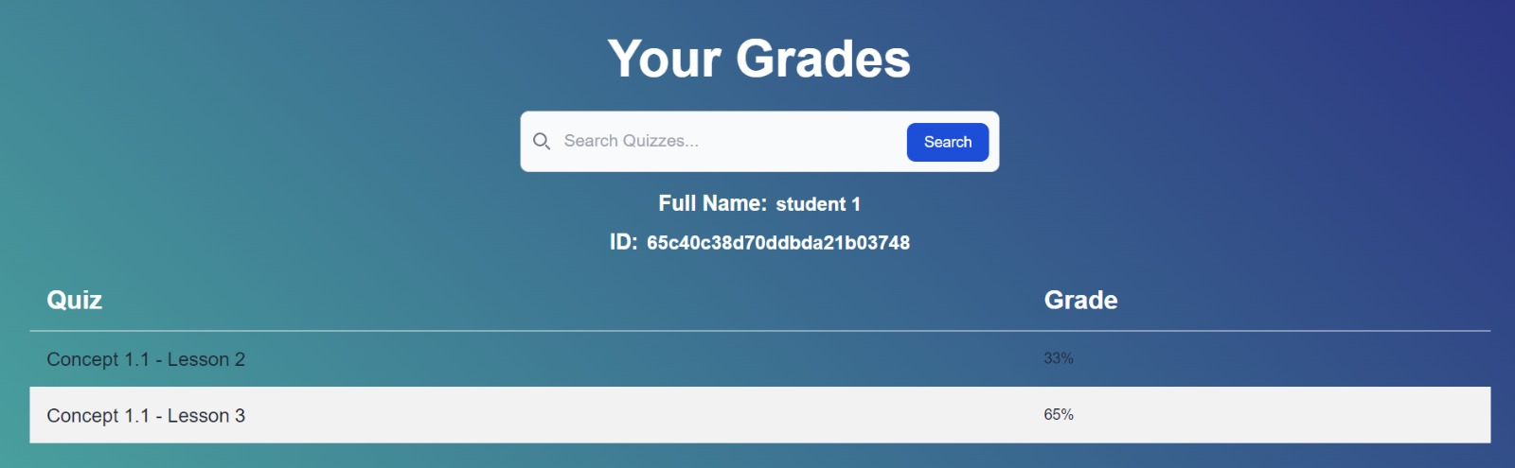
49

Slide 53
Future work
09

Slide 54
Future work
01
02
The most challenging aspect we face is increasing the performance of each model to improve accuracy while also reducing the runtime of each model ta a maximum of 1 to 2 minutes.
We can introduce additional features in the future to better meet the needs of both teachers and students
51

Slide 55
References
10

Slide 56





References
Johnson, R., & White, L. (2022). COLING 2022 Shared Task: LED finetuning and recursive summary generation for automatic summarization of chapters from novels. In Proceedings of the 29th International Conference on Computational Linguistics (pp. 123-135). https://aclanthology.org/2022.creativesumm-1.3.pdf
Beltagy, I., Peters, M. E., & Cohan, A. (2020). Longformer: The long-document transformer. arXiv preprint arXiv:2004.05150 https://arxiv.org/pdf/2004.05150.pdf
Doe, J., & Smith, A. (2023). Transformer-based models for long document summarization in financial domain. Journal of Financial Data Science, 5(2), 123-145. https://aclanthology.org/2022.fnp-1.10.pdf
Chen, X., & Wang, Y. (2022). MQAG: Multiple-choice question answering and generation for assessing information consistency in summarization. IEEE Transactions on Knowledge and Data Engineering, 34(6), 1234-1247. https://aclanthology.org/2023.ijcnlp-main.4.pdf
Zhang, X., & Li, Y. (2023). LHS712EE at BioLaySumm 2023: Using BART and LED to summarize biomedical research articles. In Proceedings of the BioLaySumm 2023 Conference (pp. 56-67). New York, NY: Association for Computational Linguistics. https://aclanthology.org/2023.bionlp-1.66.pdf
53

Slide 57
Pre-trained models used with the help of hugging face
Question Answer
Summary
Distractor
potsawee/t5-large-generation-race-Distractor
potsawee/t5-large-generation-squad-QuestionAnswer
pszemraj/led-large-book-summary
54

Slide 58

Thanks!

